Slide 1
Password Manager
COSC Senior Design Project Matthew Bare and Tyler O’Dowd

Slide 2
Problem: Password Management
Modern problems require modern solutions
Accessible from any device
Accessible anywhere that has an internet connection
Stored securely
Retrieved securely
Robust encryption
Notes:
Matt: Break down each bullet point and explain why each one is necessary.

Slide 3


Picking the right tools for the job
Tech Stack: Flutter + Firebase
Multiplatform*
Front and back end in a single language
Robust security options out of the box
Google properties play well together
Notes:
Tyler: Talk about cool things that Flutter and Firebase offered to the project: Web + Many OS Firebase is encrypted at rest -> multi layered encryption scheme UI+Backend in one package Libraries+DB -> end goal OAuth+Crypto Libs

Slide 4

Utilizing available resources
Sought out guidance and advice from graduate student mentors at the Cybersecurity Education and Research Center (CEDAR)
Notes:
Matt: CEDAR graduate students offered insight at every stage of development

Slide 5
Security Considerations Made
Defense in Depth: Keep User Data Safe With Multiple Security Layers
Encryption
Password data encrypted/decrypted locally
Keys generated dynamically
Communication with Firebase encrypted via HTTPS
Firebase database encrypted at rest
Authentication
OAuth 2.0 Tokens
Dynamically generated keys act as secondary authentication
Database Management
Prepared statements
Firebase input sanitization
Notes:
Matt: Don’t go too ham explaining why each of these is important, but instead pitch it as each one being a layer in the greater security decisions.

Slide 6
Additional Security Considerations Made
Principle of least Privilege
Standard users are only allowed to view and modify their own data
Higher privileges granted for administrators
Passwords are never displayed in plain text
Zero knowledge architecture
Full database is never decrypted, only individual entries
Notes:
Matt: Keep rambling Zero knowledge architecture -> we don’t know anything about user data because it’s encrypted before it ever gets to cloud database

Slide 7
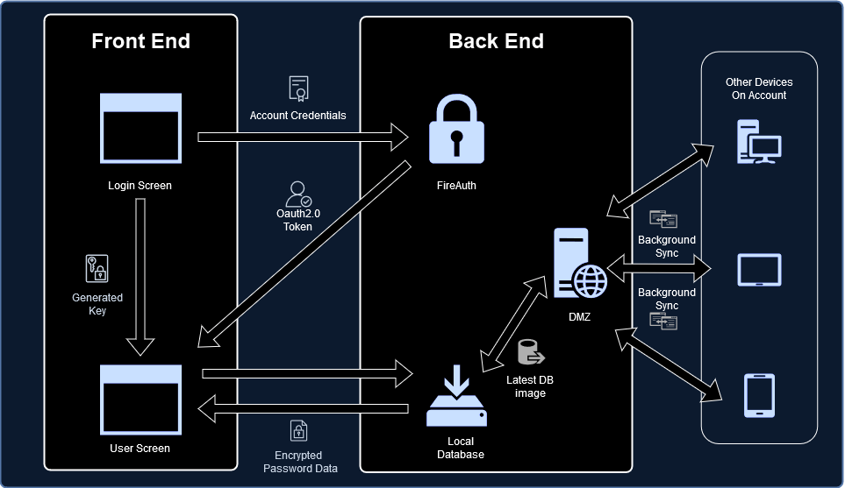
What we planned
Mobile, desktop, and web app
Local database
Background syncing
Git-like revisions
DMZ
Notes:
Tyler: Make our original idea sound like the most secure thing ever

Slide 8
Pitfalls: We had a lot of them
Flutter is a comparatively new framework with sparse documentation
Cryptography and encryption packages aren’t independently audited
Google properties update frequently, often breaking things
Losing group members led to a reduced project scope
“It works on my machine”
Deprecation of Firebase desktop OS APIs
Notes:
Both Matt & Tyler complain politely about how shit this process ended up being

Slide 9
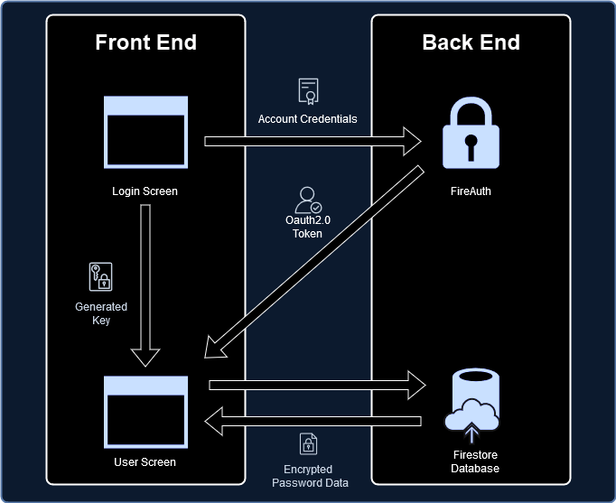
What we made
Web and IOS/Android* app
Cloud database
End to end security via HTTPS
Multi-layered encryption
Simple, easy to use interface
Notes:
Matt: Explain how the present features still keep user data safe.

Slide 10
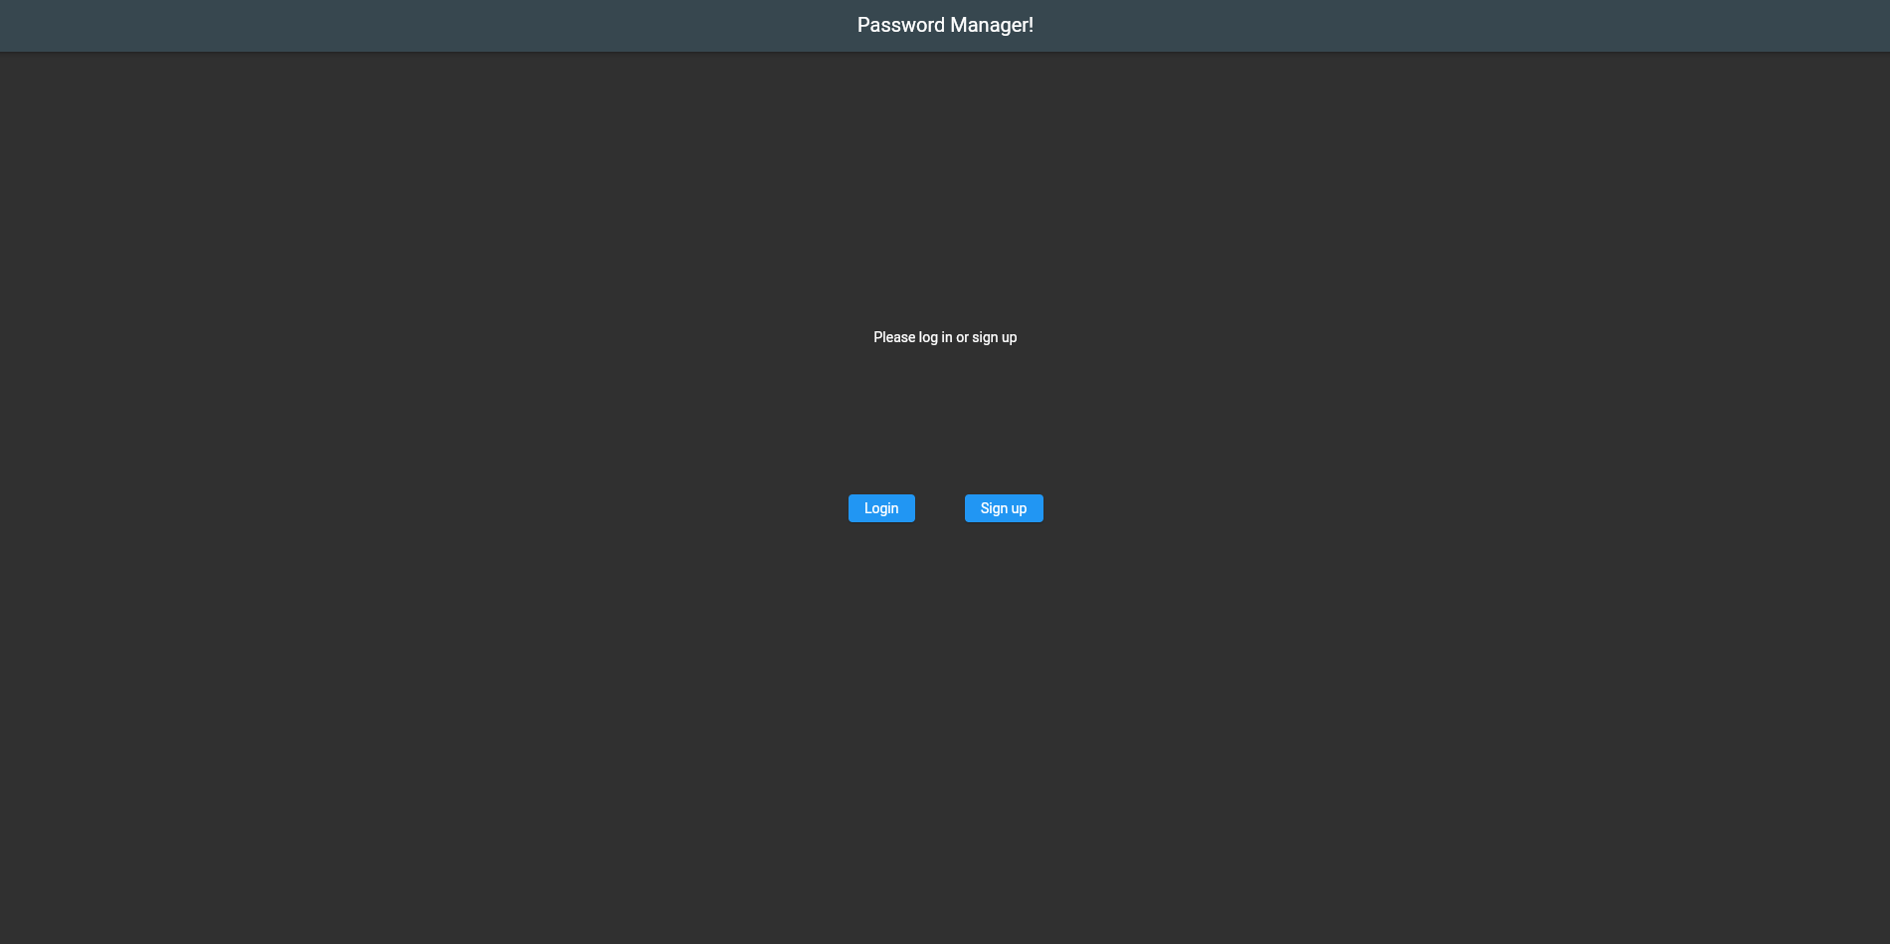
Landing Page
Notes:
Tyler: Show them around the app, this is all you until future developments

Slide 11
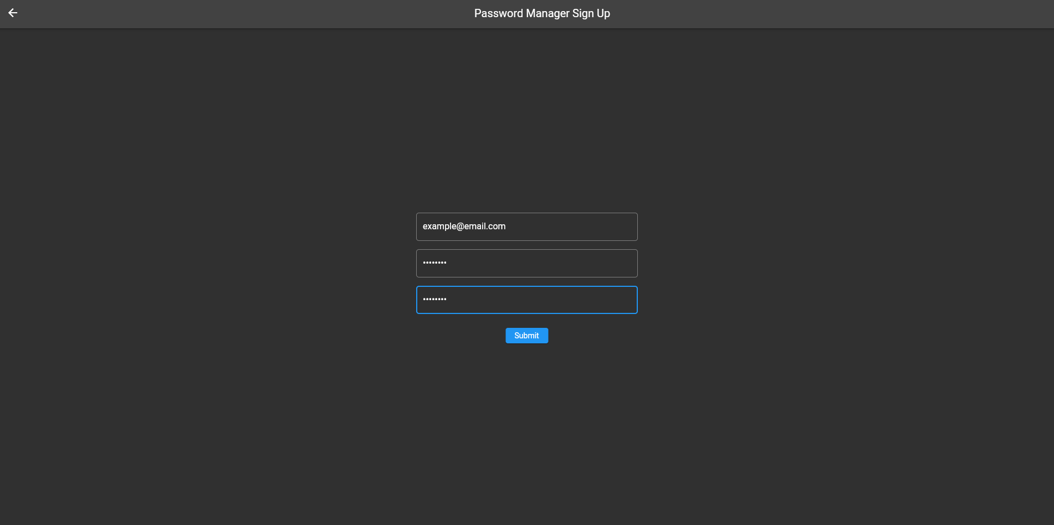
Account Creation
Notes:
Let everyone know that the loging screen (not in presentation) looks very much the same.

Slide 12

Newly Made User Screen
Notes:
There’s nothing here because this is a brand new user. Let’s add a password by clicking the little green button.

Slide 13
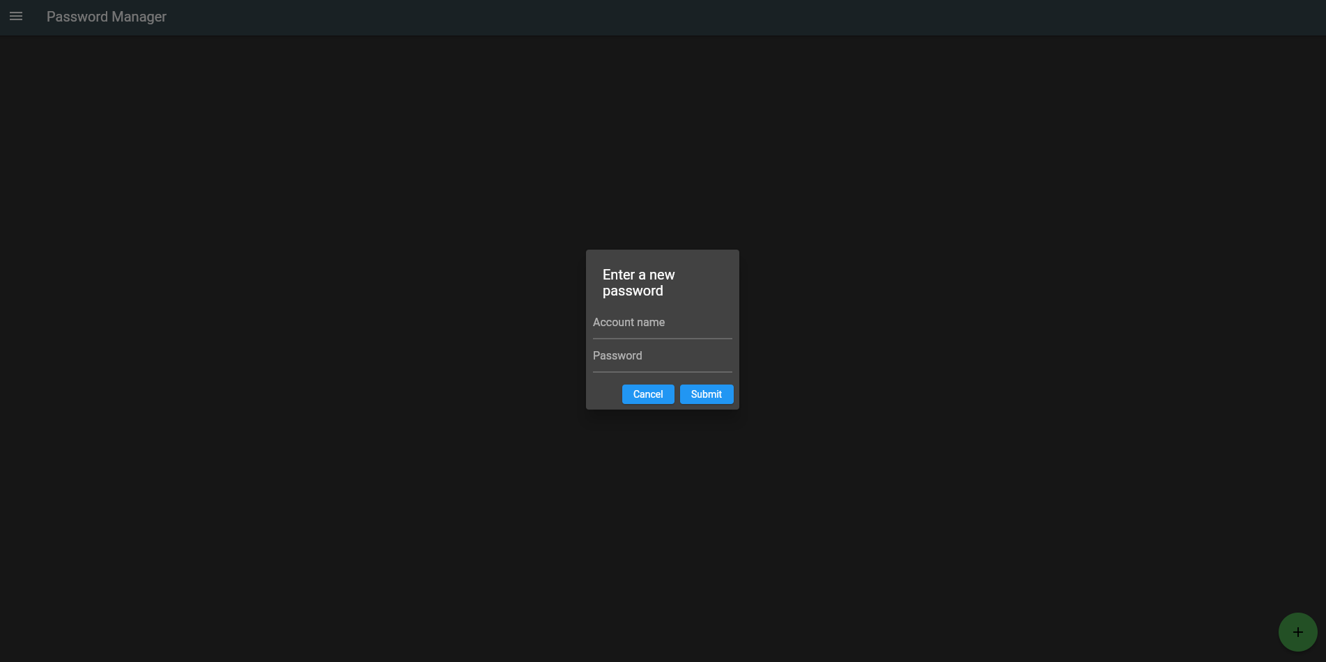
Adding Passwords to Database
Notes:
We’re adding a password yaaaaay

Slide 14
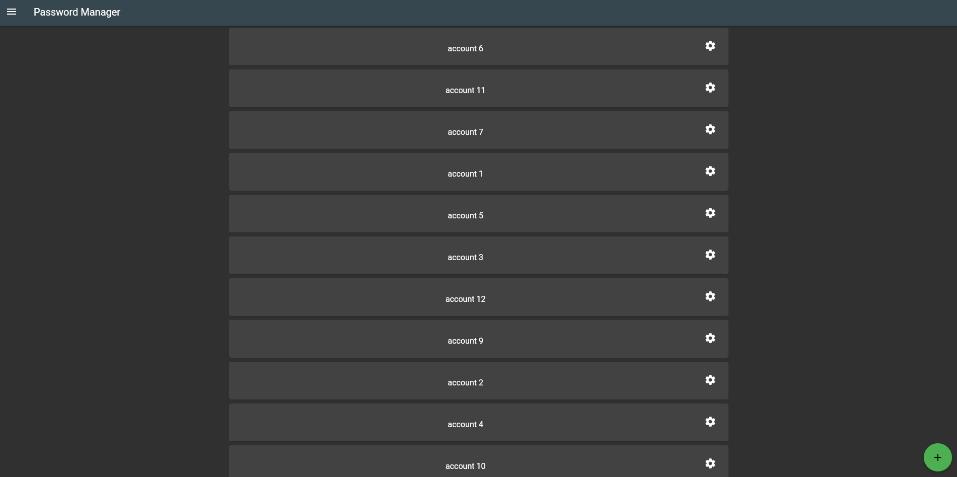
Showing Stored Passwords
Notes:
This is what the user screen will look like once many passwords have been added to the database. Explain that clicking on a card decrypts and copies the password to the clipboard. Let’s modify one of them by clicking the little gear icon.

Slide 15
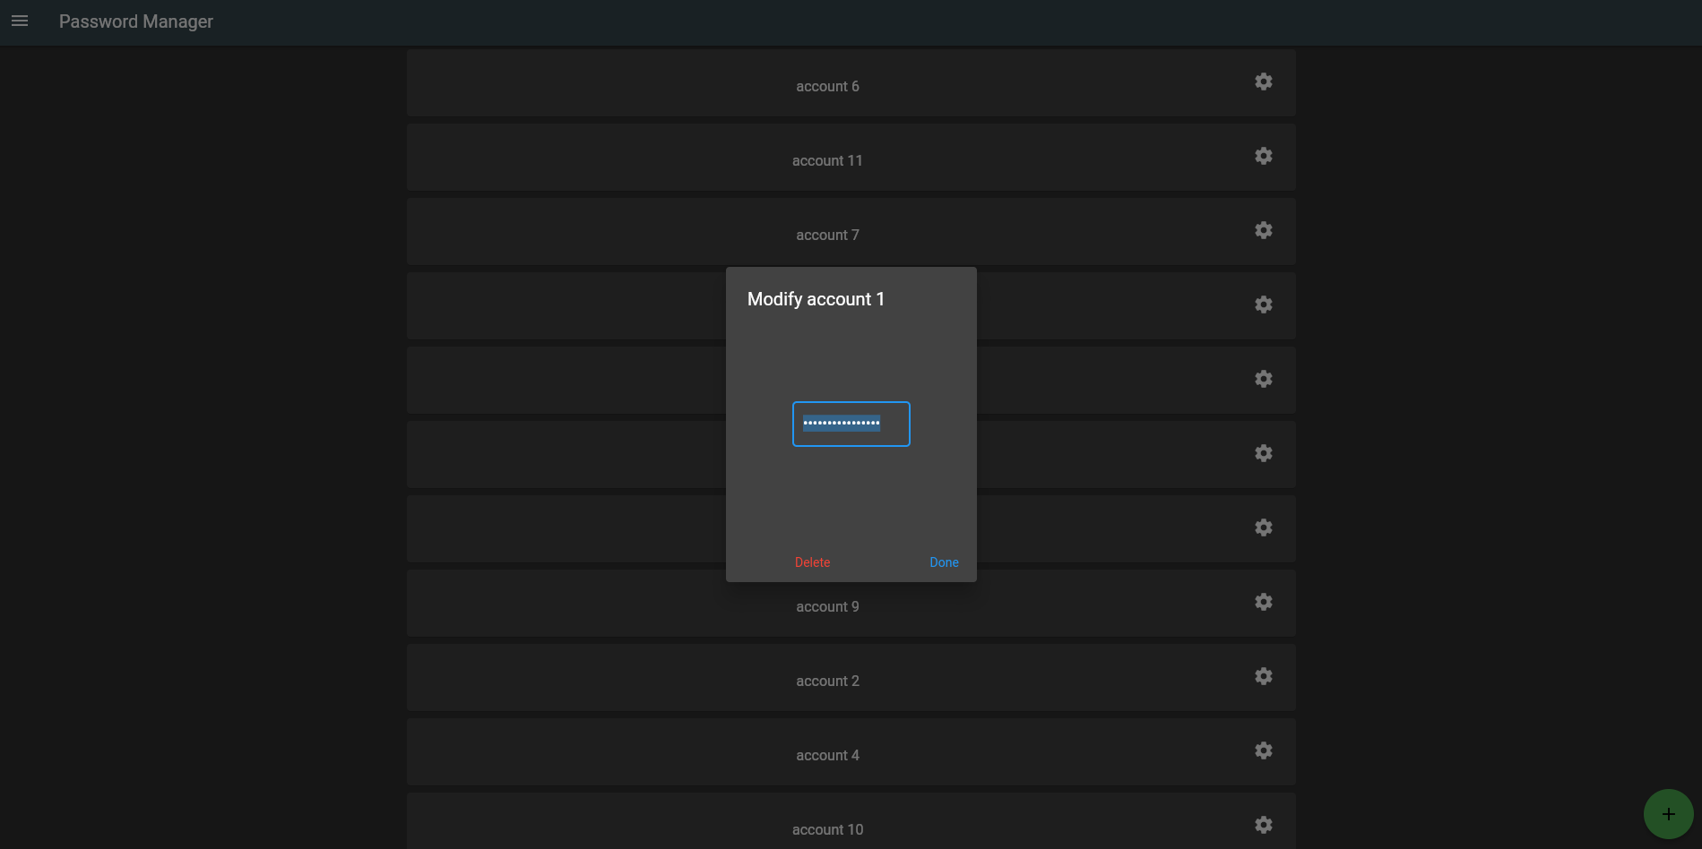
Modifying a Stored Password
Notes:
Here we can change the password associated with this account. Let’s take a look at the other features of the app.

Slide 16
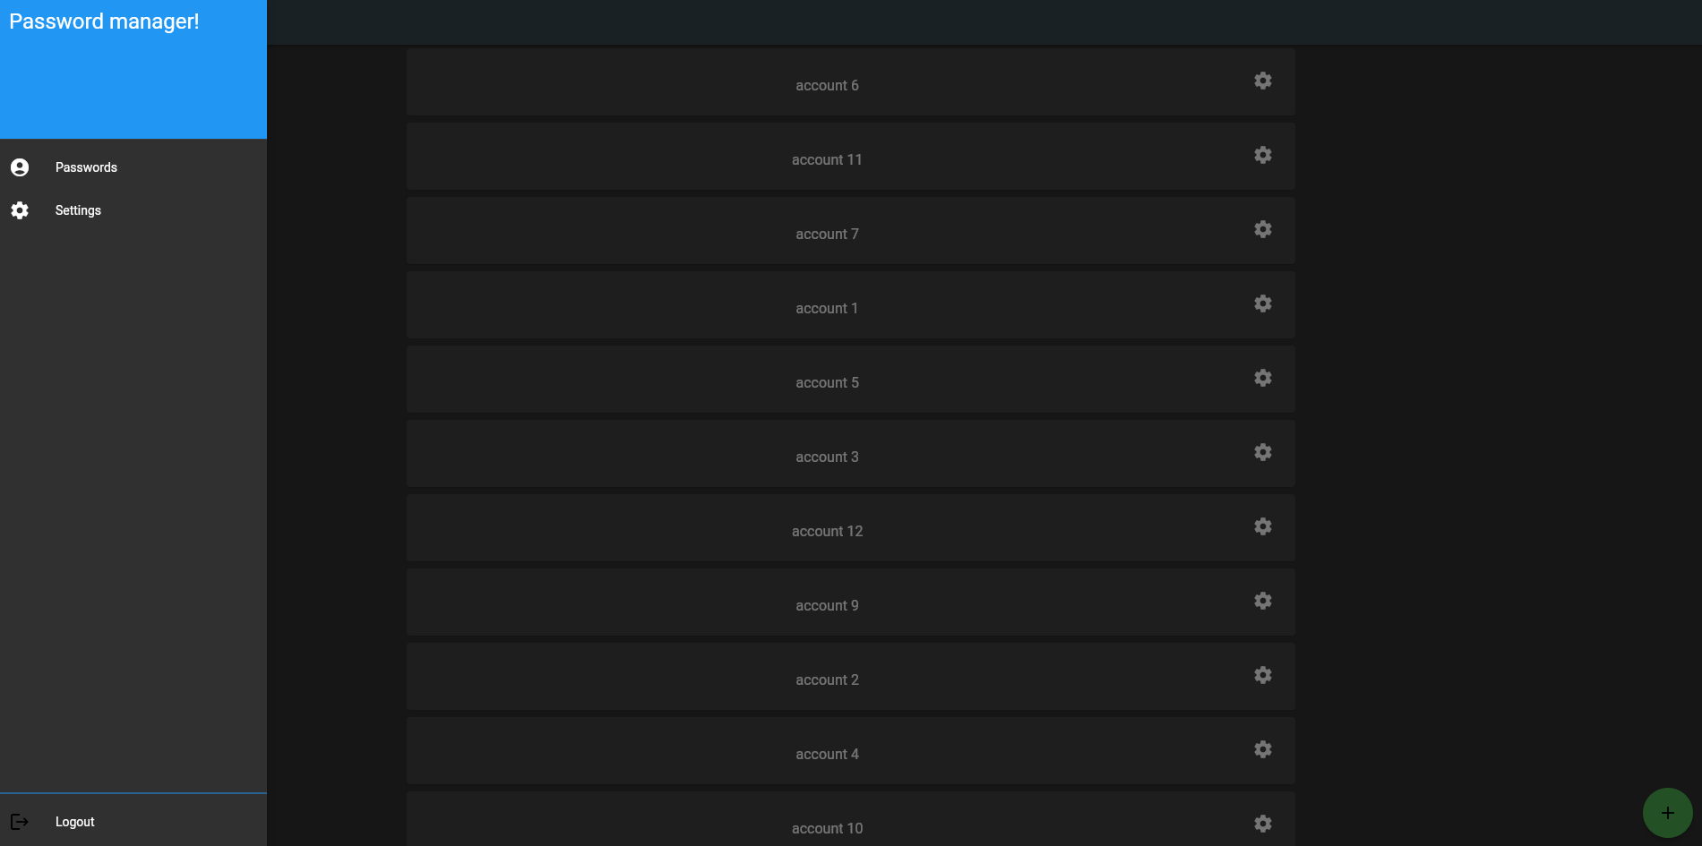
App Navigation
Notes:
Basic app navigation, password page, settings page and logout button.

Slide 17
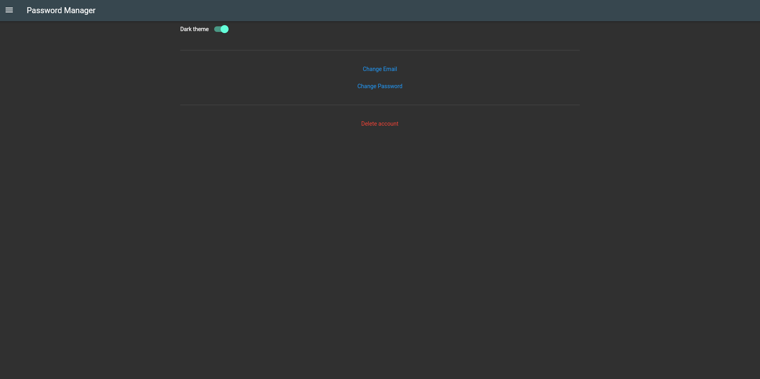
User Settings
Notes:
Settings page stuff

Slide 18
Future Revisions
Localize the user’s database for heightened security
Create seamless syncing between networked device databases
Then removing the 3rd party Database
Implement multiple DMZ options
Reducing reliance on 3rd party authentication services
Strong password suggestions
Expiring authentication
Remote configuration
Multi-factor authentication
Biometrics
Notes:
Matt & Tyler: This one is pretty much reading off the slide

Slide 19
Fin.
Thanks for listening!

